Slide 1
COMP 6246
Machine Learning Technologies
Recurrent Neural Network
Dr Mohammad Soorati
School of Electronics and Computer Science
University of Southampton
Notes:
All Mcq’s
Multiple correct answer
Write down your answers
2 parts of questions
Give us formulas
memorise
Formulas
Definitions
Summation of sigma = 1/n sum I from
So u can do operation
120 minutes
Yes No
And selection from 4 objectives only one

Slide 2
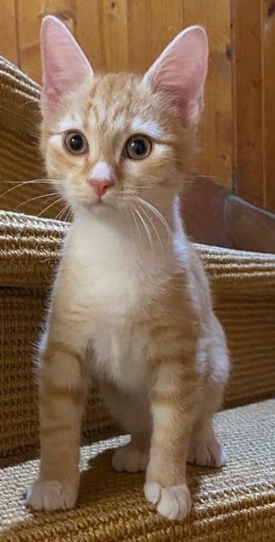
Do we need Memory?
An ambulance is behind us.
Input:
Input:
When the road is clear in front, we should …
steer our vehicle to the side of the road
continue to drive
Output?
Cat
Dog
Output:

Slide 3
Time Series
Sequence of data in time
Next data depends on previous set of data (historical data)
Examples: stock prices, weather, trajectory of a robot/car, words in a sentence, etc...
Question: how to predict time series using neural network?
  In the feedforward NN, given the same input data, the output is always the same
  In a time series, it is possible that the same input data would lead to different outputs in different time points

Slide 4






Recurrent Neural Network (RNN)
The output of hidden layer are stored in the memory.
store

Slide 5





Example
Input sequence:
$$\left[\begin{aligned}1 \\ 1\end{aligned}\right]$$
$$\left[\begin{aligned}1 \\ 1\end{aligned}\right]$$
$$\left[\begin{aligned}2 \\ 2\end{aligned}\right]$$
$$……$$
output sequence:
$$\left[\begin{aligned}4 \\ 4\end{aligned}\right]$$
4
4
store
2
2
given initial values
0
0
All the weights are “1”, no bias
1
1
All activation functions are linear

Slide 6
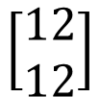
Example
Input sequence:
$$\left[\begin{aligned}1 \\ 1\end{aligned}\right]$$
$$\left[\begin{aligned}1 \\ 1\end{aligned}\right]$$
$$\left[\begin{aligned}2 \\ 2\end{aligned}\right]$$
$$……$$
output sequence:
$$\left[\begin{aligned}4 \\ 4\end{aligned}\right]$$
$$\left[\begin{aligned}12 \\ 12\end{aligned}\right]$$
12
12
store
6
6
2
2
All the weights are “1”, no bias
1
1
All activation functions are linear

Slide 7
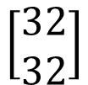
Example
Input sequence:
$$\left[\begin{aligned}1 \\ 1\end{aligned}\right]$$
$$\left[\begin{aligned}1 \\ 1\end{aligned}\right]$$
$$\left[\begin{aligned}2 \\ 2\end{aligned}\right]$$
$$……$$
output sequence:
$$\left[\begin{aligned}4 \\ 4\end{aligned}\right]$$
$$\left[\begin{aligned}12 \\ 12\end{aligned}\right]$$
$$\left[\begin{aligned}32 \\ 32\end{aligned}\right]$$
Changing the input sequence order will change the output
32
32
store
16
16
6
6
All the weights are “1”, no bias
2
2
All activation functions are linear

Slide 8


Example
Input sequence:
$$\left[\begin{aligned}1 \\ 1\end{aligned}\right]$$
$$\left[\begin{aligned}2 \\ 2\end{aligned}\right]$$
$$\left[\begin{aligned}1 \\ 1\end{aligned}\right]$$
$$……$$
output sequence:
$$\left[\begin{aligned}4 \\ 4\end{aligned}\right]$$
4
4
store
2
2
given initial values
0
0
All the weights are “1”, no bias
1
1
All activation functions are linear

Slide 9
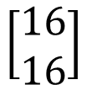
Example
Input sequence:
$$\left[\begin{aligned}1 \\ 1\end{aligned}\right]$$
$$\left[\begin{aligned}2 \\ 2\end{aligned}\right]$$
$$\left[\begin{aligned}1 \\ 1\end{aligned}\right]$$
$$……$$
output sequence:
$$\left[\begin{aligned}4 \\ 4\end{aligned}\right]$$
$$\left[\begin{aligned}16 \\ 16\end{aligned}\right]$$
16
16
store
8
8
2
2
All the weights are “1”, no bias
2
2
All activation functions are linear

Slide 10
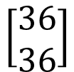
Example
Input sequence:
$$\left[\begin{aligned}1 \\ 1\end{aligned}\right]$$
$$\left[\begin{aligned}2 \\ 2\end{aligned}\right]$$
$$\left[\begin{aligned}1 \\ 1\end{aligned}\right]$$
$$……$$
output sequence:
$$\left[\begin{aligned}4 \\ 4\end{aligned}\right]$$
$$\left[\begin{aligned}16 \\ 16\end{aligned}\right]$$
$$\left[\begin{aligned}36 \\ 36\end{aligned}\right]$$
36
36
store
18
18
8
8
All the weights are “1”, no bias
1
1
All activation functions are linear

Slide 11

Recurrent neural network
Feedforward neural network
  Each connection is a forward connection
  No loops
Recurrent neural network:
  Backward connections (and therefore loops) are allowed
Simplest version: neuron + self-loop:
  Output of previous time step is also input of current step

Slide 12
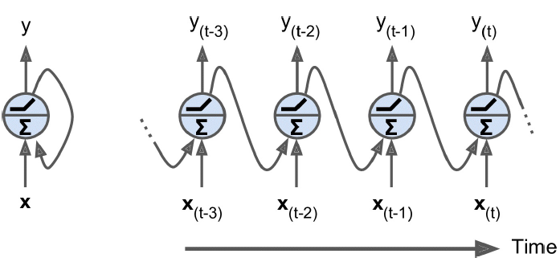
Recurrent neural network
Simplest version: neuron + self-loop:
  Output of previous time step is also input of current step
  Unrolling the network through time

Slide 13


Learning
Backpropagation through time (BPTT)
$$w$$
$$w←w−η∂L∕∂w$$
Unrolling an RNN creates a copy for each time step
All copies share the same weights, which are trained together.

Slide 14
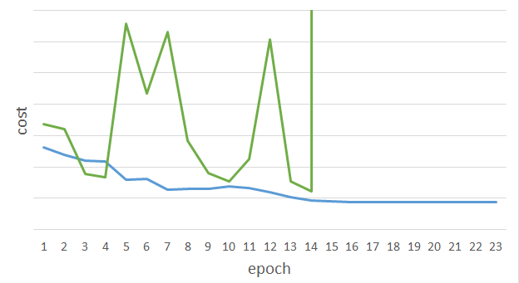
RNN learning
RNN network is not always easy to train
sometimes
Total Loss
Lucky
Epoch

Slide 15




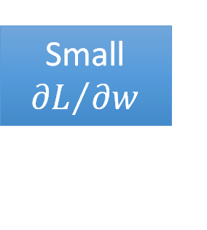

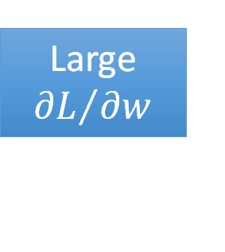


Exploding Gradient
$$w=1$$
$$y^{1000}=1$$
Large
$${∂L}/{∂w}$$
$$w=1.01$$
$$y^{1000}≈20000$$
$$w=0.99$$
$$y^{1000}≈0$$
Small ${∂L}/{∂w}$
$$w=0.01$$
$$y^{1000}≈0$$
=w⁹⁹⁹
y¹
y¹
y²
y³
y¹⁰⁰⁰
1
1
1
1
1
w
……
1
w
w
w
1
1
1
1
1
1
0
0
0
Notes:
A little jump lead to huge/big value from 1.01 to if 1 then lead to big errors instead of small jumps.

Slide 16
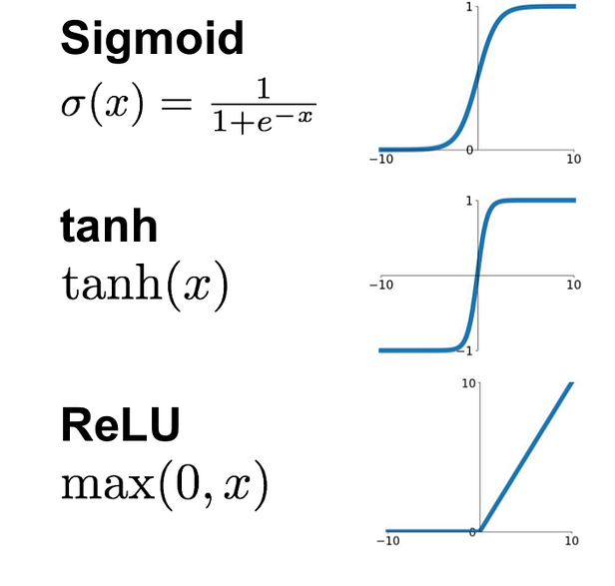
Vanishing Gradients
Sigmoid and tanh have vanishing gradients
RNNs have short term memory
Solution?
Notes:
Why and for which each activation functions used?
If value is –ives for both sigmoid and tanh the value is also vanishing
tanh use when?
Sigmoid when ?
And relu when?

Slide 17
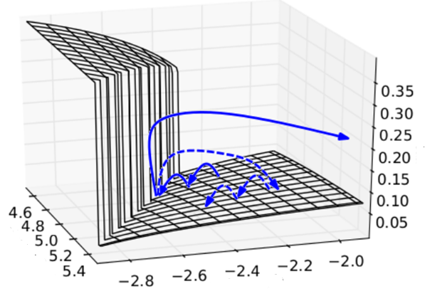
Clipping
A solution for exploding gradient
where we clip gradient into [T_{min},T_{max}]
The error surface is either very flat or very steep.
Clipping
Cost
Total Loss
w₂
w₁
  [Razvan Pascanu, ICML’13]

Slide 18
Long Short-Term Memory (LSTM)
Other part of the network
Special Neuron:
4 inputs,
1 output
Signal control the output gate
Output Gate
(Other part of the network)
Memory
Cell
Forget Gate
Signal control the forget gate
(Other part of the network)
Signal control the input gate
Input Gate
LSTM
(Other part of the network)
Other part of the network
Notes:
Activation function is relu/sigmoid and tanh ? Check where all they used?
Which kind of activation function is good? Relu or sigmoid? Or which one
sigmid is actually designed for this o & 1.
tanh use when?
Sigmoid when ?
And relu when?

Slide 19
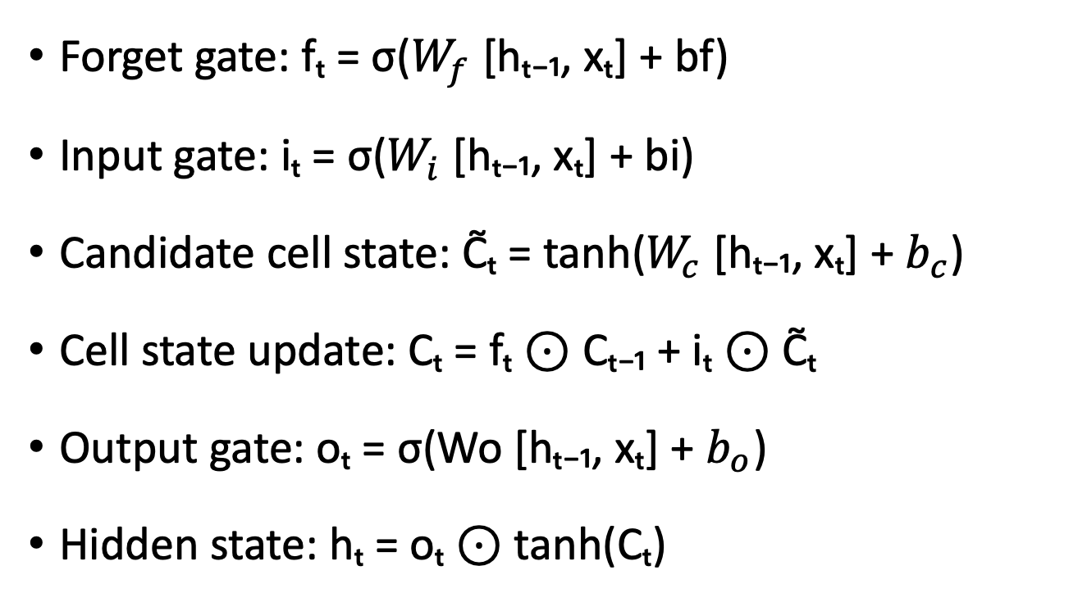
Long Short-Term Memory (LSTM)
Forget gate: fₜ = σ($W_{f}$ [hₜ₋₁, xₜ] + bf)
Input gate: iₜ = σ($W_{i}$ [hₜ₋₁, xₜ] + bi)
Candidate cell state: C̃ₜ = tanh($W_{c}$ [hₜ₋₁, xₜ] + $b_{c}$)
Cell state update: Cₜ = fₜ ⊙ Cₜ₋₁ + iₜ ⊙ C̃ₜ
Output gate: oₜ = σ(Wo [hₜ₋₁, xₜ] + $b_{o}$)
Hidden state: hₜ = oₜ ⊙ tanh(Cₜ)
Notes:
4 input and 1 output

Slide 20
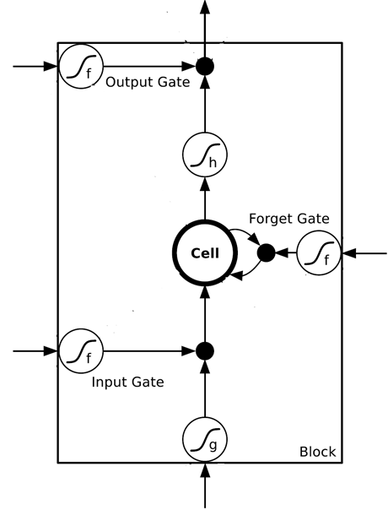
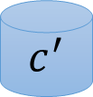
$$a$$
$$=h\left(c^{′}\right)f\left(z_{o}\right)$$
$$z_{o}$$
multiply
Activation function f is usually a sigmoid function
$$f\left(z_{o}\right)$$
$$h\left(c^{′}\right)$$
Between 0 and 1
Mimic open and close gate
$$c$$
$$f\left(z_{f}\right)$$
c
$$c^{′}$$
$$z_{f}$$
$$cf\left(z_{f}\right)$$
$$c^{′}=g\left(z\right)f\left(z_{i}\right)+cf\left(z_{f}\right)$$
$$f\left(z_{i}\right)$$
$$g\left(z\right)f\left(z_{i}\right)$$
$$z_{i}$$
multiply
$$g\left(z\right)$$
$$z$$
Notes:
Tanh is linear but for this case
3 are sigmoid signal control valves

Slide 21
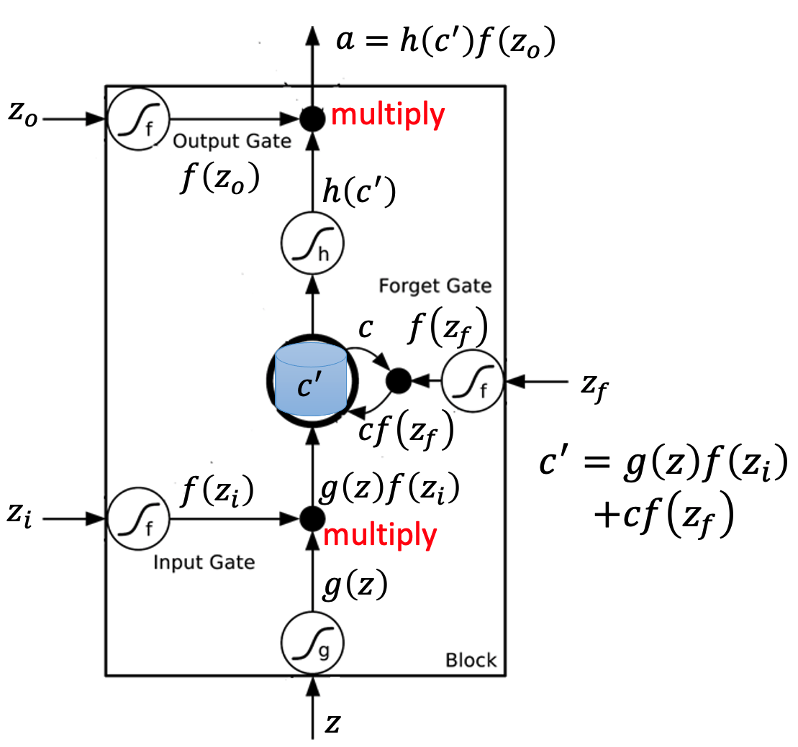




x₁
0
y
$$y$$
0
0
0
7
0
x₂
0
+
x₃
100
0
x₁
1
-10
100
0
0
+
x₂
x₁
0
x₃
x₂
100
+
10
1
x₃
0
1
-10
+
$$x_{1}$$
3
1
0
4
1
0
2
0
0
1
0
1
3
-1
0
1
0
0
0
$$x_{2}$$
x₁
x₂
x₃
1
$$x_{3}$$
Notes:
How this networks behave
for simplicity its linear
First round what I get ?
100-10 = 90
A sigmoid of 90 =? Find it
-10 is sigmoid of 0
Sequence 3+4 = 7
Go and find how it works and find calculation

Slide 22
3
0
≈0
y
$$y$$
0
0
0
7
0
1
0
+
≈0
3
0
100
0
3
1
-10
0
100
0
3
+
1
3
≈1
0
0
100
≈1
3
1
+
10
1
3
0
0
1
-10
+
$$x_{1}$$
3
1
0
4
1
0
2
0
0
1
0
1
3
-1
0
1
0
0
0
$$x_{2}$$
3
1
0
1
$$x_{3}$$

Slide 23
4
0
≈0
y
$$y$$
0
0
0
7
0
1
0
+
≈0
7
0
100
0
4
1
-10
7
100
0
3
+
1
4
≈1
0
0
100
≈1
4
1
+
10
1
4
0
0
1
-10
+
$$x_{1}$$
3
1
0
4
1
0
2
0
0
1
0
1
3
-1
0
1
0
0
0
$$x_{2}$$
4
1
0
1
$$x_{3}$$

Slide 24
2
0
≈0
y
$$y$$
0
0
0
7
0
0
0
+
≈0
7
0
100
0
2
1
-10
7
100
0
+
0
2
≈1
0
0
100
≈0
0
0
+
10
1
2
0
0
1
-10
+
$$x_{1}$$
3
1
0
4
1
0
2
0
0
1
0
1
3
-1
0
1
0
0
0
$$x_{2}$$
2
0
0
1
$$x_{3}$$

Slide 25
1
0
≈7
y
$$y$$
0
0
0
7
0
0
0
+
≈1
7
1
100
0
1
1
-10
7
100
0
+
0
1
≈1
0
1
100
≈0
0
0
+
10
1
1
1
0
1
-10
+
$$x_{1}$$
3
1
0
4
1
0
2
0
0
1
0
1
3
-1
0
1
0
0
0
$$x_{2}$$
1
0
1
1
$$x_{3}$$

Slide 26
3
0
≈0
y
$$y$$
0
0
0
7
0
-1
0
+
≈0
0
0
100
0
3
1
-10
0
100
0
7
+
-1
3
≈0
0
0
100
≈0
0
-1
+
10
1
3
0
0
1
-10
+
$$x_{1}$$
3
1
0
4
1
0
2
0
0
1
0
1
3
-1
0
1
0
0
0
$$x_{2}$$
3
-1
0
1
$$x_{3}$$

Slide 27




Original Network:
Simply replace the neurons with LSTM
……
……
$$a_{1}$$
$$a_{2}$$
$$z_{1}$$
$$z_{2}$$
x₁
x₂
Input

Slide 28


$$a_{1}$$
$$a_{2}$$
+
+
+
+
+
+
+
+
x₁
x₂
Input

Slide 29
LSTM
c^{t-1}
……
vector
z^{f}
z^{i}
z
zº
4 vectors
x^{t}

Slide 30

LSTM
y^{t}
zº
c^{t-1}
$$×$$
$$＋$$
$$×$$
z^{f}
$$×$$
z^{i}
z^{f}
z^{i}
z
zº
x^{t}
z

Slide 31
LSTM
y^{t}
y^{t+1}
c^{t-1}
c^{t}
c^{t+1}
$$×$$
$$＋$$
$$×$$
$$×$$
$$＋$$
$$×$$
$$×$$
$$×$$
z^{f}
z^{i}
z
zº
z^{f}
z^{i}
z
zº
c^{t-1}
h^{t-1}
x^{t}
c^{t}
h^{t}
x^{t+1}

Slide 32
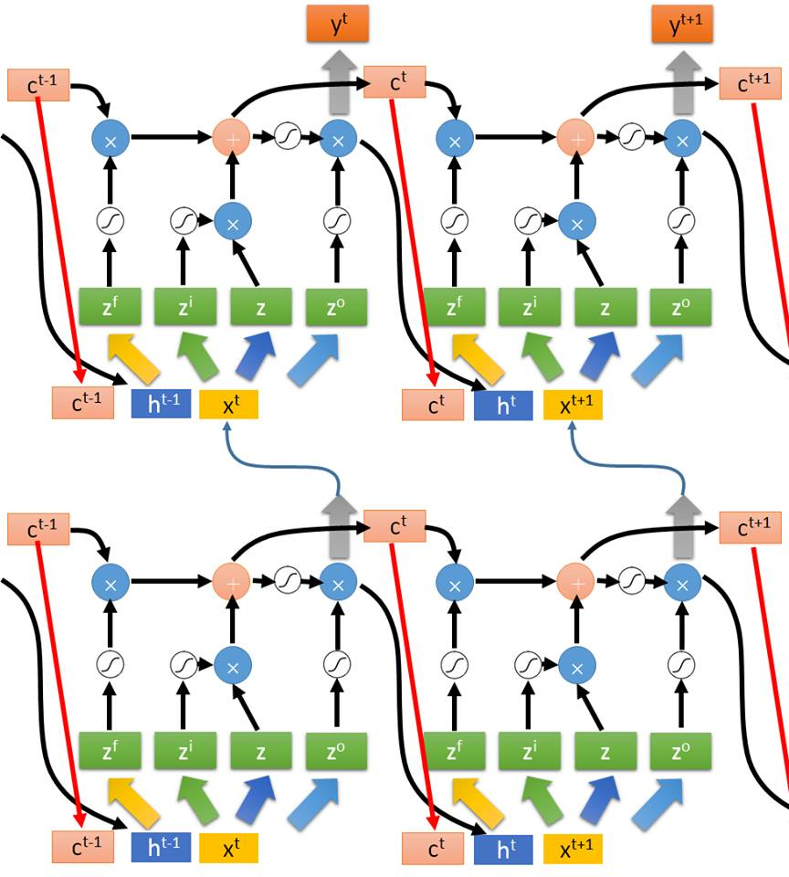
Multiple-layer
LSTM
No worries if you cannot understand this. Scikit-Learn can handle it.
It supports
“LSTM”, “GRU”, “SimpleRNN” layers
This is quite standard now
https://img.komicolle.org/2015-09-20/src/14426967627131.gif

Slide 33
Gated Recurrent Unit
A variant of LSTM
  In GRU, in contrast to using a forget gate, how much past information to retain or discard is determined based on (the compliment of) the input gate vector
  Less weights to train

Slide 34
Input-output Patterns
One-to-one: ordinary classification.
One-to-many: image caption generation.
Many-to-one: sentiment classification.
Many-to-many: sequence labelling or sequence generation.

Slide 35
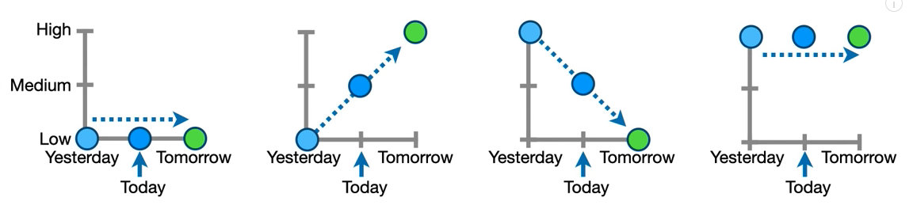
Application of RNN: time series prediction

Slide 36
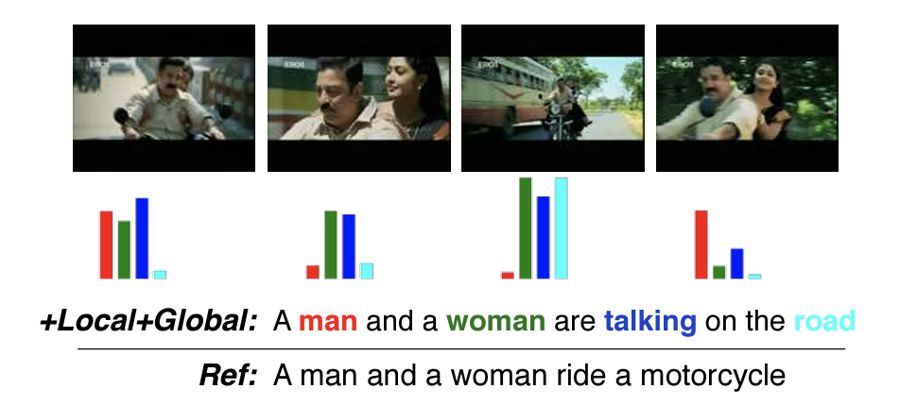
Applications of RNN: Image Captioning
Li Yao, Atousa Torabi, Kyunghyun Cho, Nicolas Ballas, Christopher Pal, Hugo Larochelle, Aaron Courville, “Describing Videos by Exploiting Temporal Structure”, ICCV, 2015

